Slide 1

Preparing for a Video Interview

Slide 2
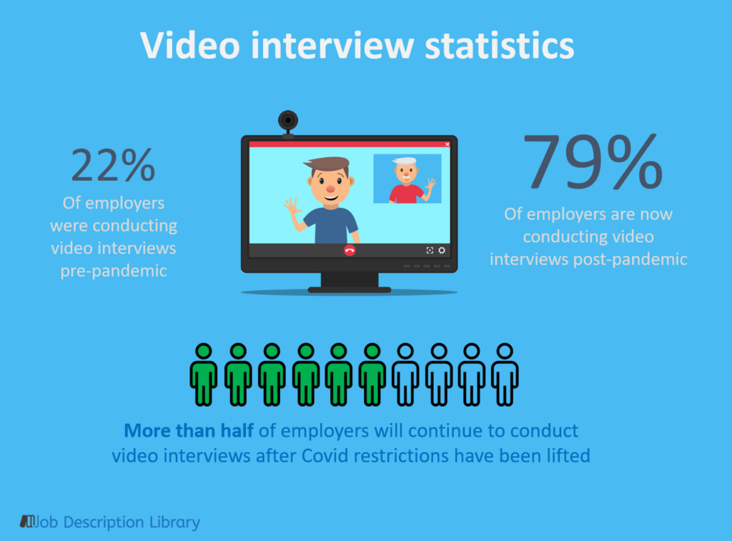

Slide 3
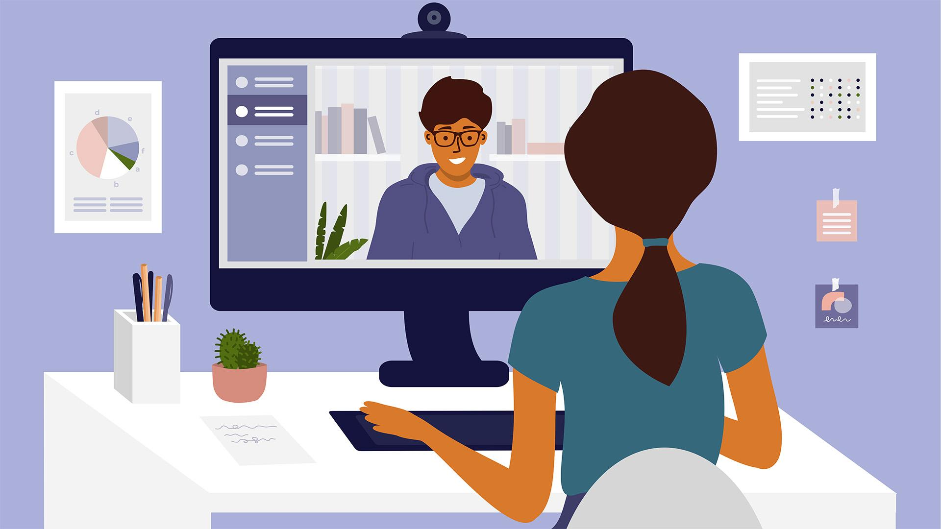
Virtual Interview Tips
Test your webcam and keep it just above eye level.
Turn your phone on silent.
Have a pen and notepad close by – but don’t doodle!
Ensure your internet connection is stable.
Keep children and pets out of the room.
Use headphones with a built-in microphone or headphones with a separate microphone.

Slide 4
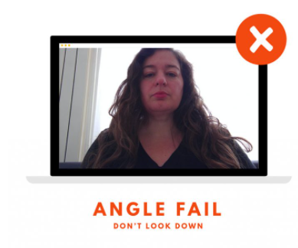
Webcam Height
Humans don’t like to be looked down on. We have an immediate visceral reaction to the experience of being looked down on. You want the camera to be roughly at your eye line, maybe a tiny bit higher. That way you’re able to make eye contact.

Slide 5
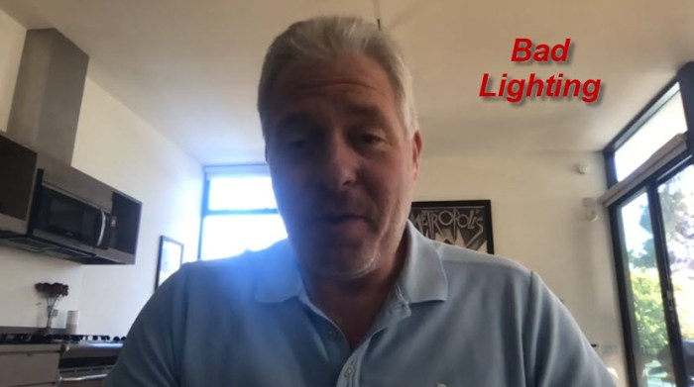
What’s Wrong With His Presentation?
Unprofessional background

Slide 6
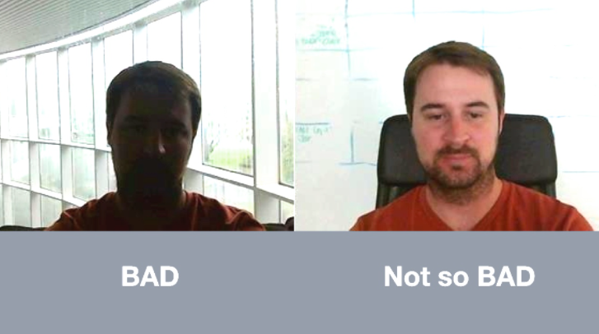
Lighting
Light from behind: the interviewer won’t be able to see your face.
Light from the side: half of your face will have a shadow.
Light in front of you is always best.
Dim room: the setting will be too shadowy.
Natural light is always best.
If natural light is not available - put a lamp in front of you.

Slide 7
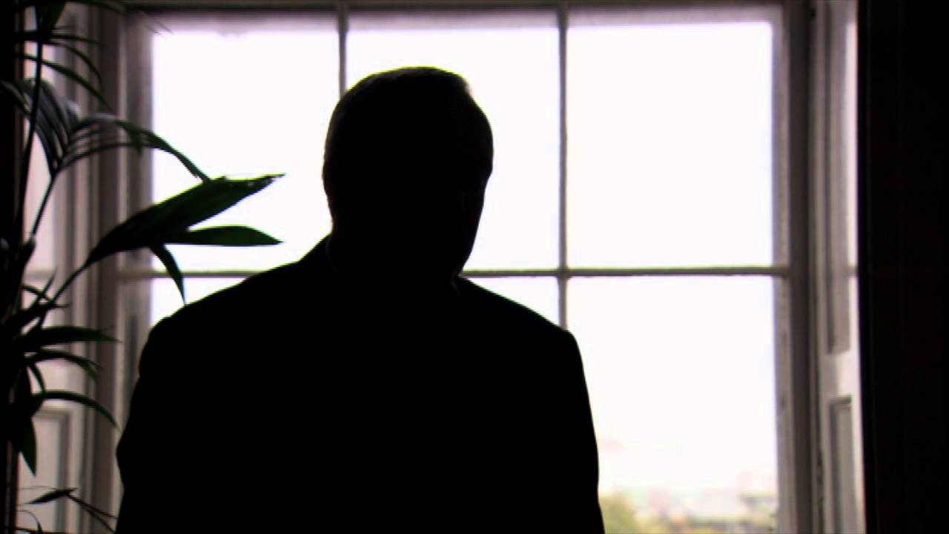
Can You See His Face?

Slide 8
Backgrounds
Find an uncluttered room – free of mess and background noise.
A solid background is best.
Avoid showing your dorm in the background – you want to look like a professional candidate and not a student.
Some platforms offer the ability to blur out your background – only use this when a solid background is not available.
No animated backgrounds! They are unprofessional and distracting (underwater, palm trees, space).

Slide 9
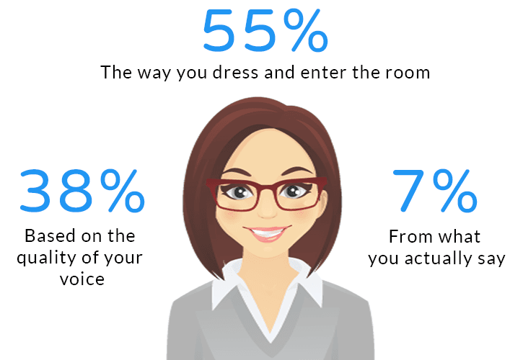
Body Language
Be mindful of your body language!
Keep eye contact 50% of the time with the camera – practice this so it feels natural.
Posture – sit up straight and be confident. Good posture also promotes better breathing which calms nerves!
Avoid: yawning, slouching, fidgeting, rocking, and distracting body movements and facial expressions.

Slide 10
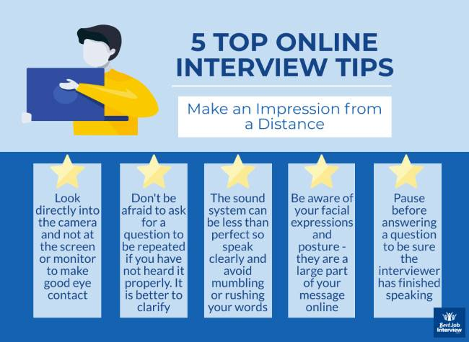

Slide 11

When Should You Arrive?
Arrive a minute or two early if the interviewer has opened the meeting.
Never initiate the meeting yourself.
Don’t harass the interviewer about starting earlier.
Arriving too early will feel intrusive and bothersome.
Don’t arrive late – interviewers may be more attentive to delays when sitting in an empty virtual meeting.

Slide 12
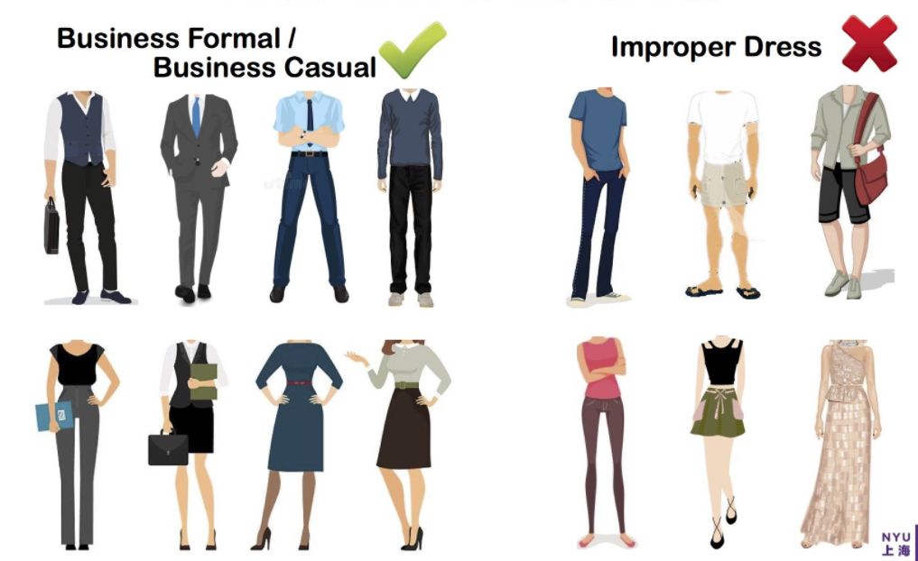
Dress Professionally!

Slide 13

Dress for the Office
Dress as you would for the office. There is plenty of evidence you can alter your mindset with the help of your wardrobe. Will your interviewer know if you’re wearing slacks or sweats? Likely not. Do the slacks make you more qualified? Still nope. But in being prepared for the part, you’ll be more confident in how you present yourself and having the right attitude DOES make you more qualified.

Slide 14
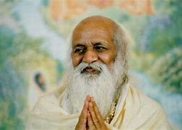
Use Your Full Potential
“By not using his full potential, man is not able to fulfill the purpose of his life. He is found suffering in many ways because he is not using the full conscious capacity of his mind; he is not using the great energy he carries within himself. He is not experiencing and expressing in his life the abundance of absolute bliss that he naturally possesses, the great absolute field of creativity and power that he has within himself. He is like a millionaire who has forgotten all his wealth and status and who goes begging in the street and at every moment feels the lack of money.” –Maharishi

